Slide 1

“If I can buy it, it must be safe”
Katrina Phillips, Chief Executive
Child Accident Prevention Trust

Slide 2
About us
Founded by two paediatricians who wanted to stop treating preventable injuries
Approaching our 40th anniversary as a charity
Focus on reducing death, acquired disability and serious injury to children

Slide 3
Our vision
Children lead active, healthy lives,
safe from the disabling effects
of serious accidental injury

Slide 4
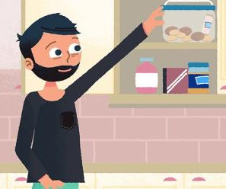
Our approach
Empowering families
Supporting professionals
Influencing for change
Tackling inequalities
Partnerships

Slide 5
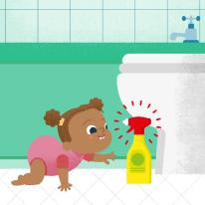
Child Safety Week 7-13 June
Free resources to use and share:
Fact sheets x 7
Translations x 5 languages
Session plans x 8
Display materials
Illustrated social media posts and animations
Share because you care

Slide 6
“If I can buy it, it must be safe”
Online sales growth hit a 13-year high in May 21
Where we can buy – online marketplaces eg Amazon, eBay, Fruugo
Concerns about products that are counterfeit or don’t meet UK safety standards

Slide 7
Toy safety
British Toy & Hobby Association ‘Don’t Toy with Children’s Safety’
60% of toys tested had serious safety failings:
Super strong magnets
Accessible lithium coin cell batteries
Small parts that can choke
Cords long enough to strangle.

Slide 8
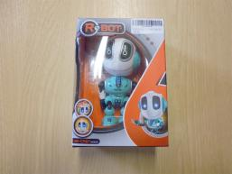
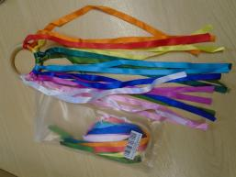
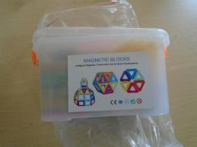
Serious safety failings

Slide 9
Consumer attitudes
“Consumers assumed that brands would
only make safe products, and that regulations
were in place to stop potentially dangerous products from entering the market.”
Office for Product Safety & Standards

Slide 10
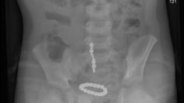
Super strong magnets
“He is a really lucky boy. But the damage that they did is absolutely unreal. They burned holes in the intestines. Whenever they opened him up some of his intestines already leaked out.”
Mother of three-year-old

Slide 11
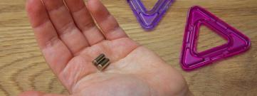
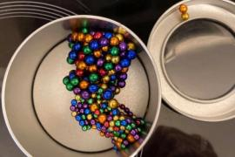
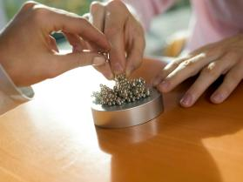
Building toys & jewellery kits

Slide 12
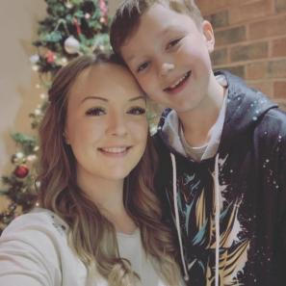
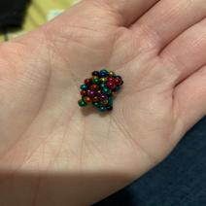
Fake tongue piercings

Slide 13

NHS safety alert

Slide 14
OPSS safety alert
IMPORTANT SAFETY ALERT
Small High Powered Magnetic Products
“These products present a risk of serious injury
or fatality if two or more magnets are ingested.”

Slide 15
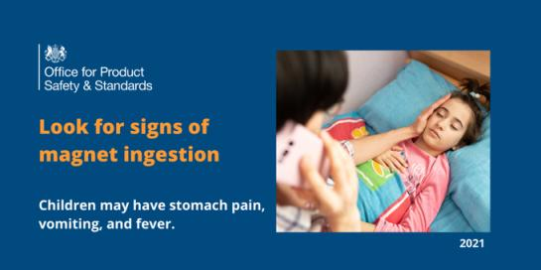
OPSS awareness raising

Slide 16
Stay in touch
Join our 2,300 subscribers across Scotland https://www.capt.org.uk/csw-sign-up
Facebook https://www.facebook.com/ChildAccidentPreventionTrust/
Twitter https://twitter.com/captcharity and https://twitter.com/childsafetyweek
Website: www.capt.org.uk
Email: katrina.phillips@capt.org.uk

Slide 17
Trading Standards – Product Safety
Christopher Bell – National Product Safety LEAD OffICER
Christopher.Bell@Edinburgh.gov.uk

Slide 18
Objectives
  Toy Safety and Other Legislation
  Emerging Risks/Re-emerging Risks
  Incidental Risks

Slide 19
Toy Safety Regulations (and Others)
Who
What
Designed or intended for use in play (whether or not exclusively) by children under 14.
Toys
Childcare Articles
Clothes
Electricals
Cosmetics
Sports Equipment
Jewellery

Slide 20
Toy Safety Regulations (and Others)
Incidental Risk
Emerging Risks
Other things around the home
  Button Cell Batteries
  Money
  Liquitabs
  E cigarette Liquids
New Products/Lifestyle
  Trampolines
  Hoverboards
  Bling Dummies

Slide 21
Child Safety Week
  Prevention
  How do we prevent?
    Importers Project
    Ports & Borders Work
    Proactive checks of Producers
    Guidance to Business on compliance
    Awareness
    Data & Partnership

Slide 22
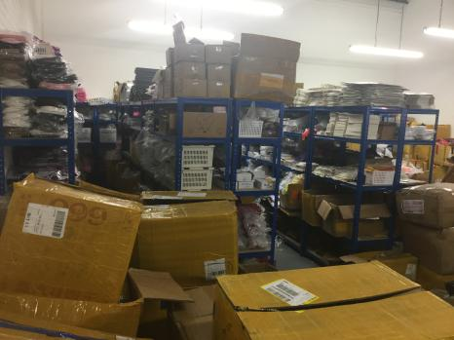
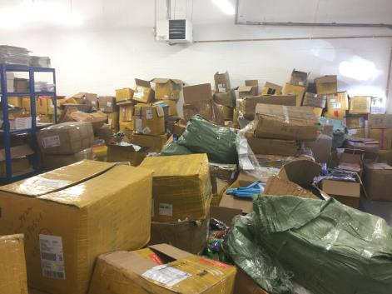
Importer Project

Slide 23
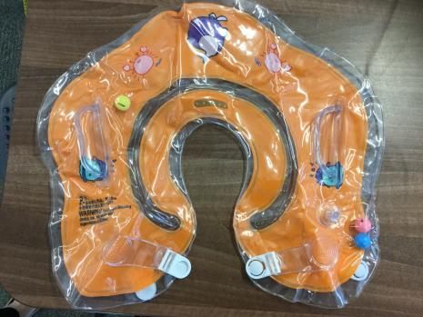
Emerging Risks
Heavy Metals in Costume Jewellery
Hidden risks (e.g. Electrical Cable)
Grey Zone Products
Social Media linked products

Slide 24
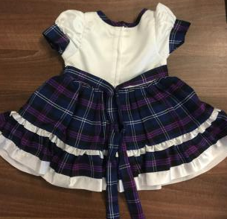
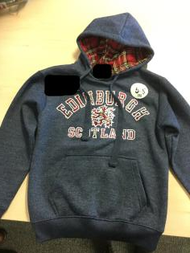
Re-emerging Risks
Magnets
Blind Cords
Hood Cords
Clothes

Slide 25
Business Advice & Consumer Awareness
Aware of and Compliant with their Responsibilities
Level Playing Field
Consumer awareness
Critical thought
Accident Data

Slide 26
Questions?
SCOTSS – National Product Safety GROUp
Christopher Bell

Slide 27



The Scottish Trauma Network
Saving lives; giving life back
Mark Lilley
Lynsay Stewart
Jenna Hills
Major Trauma Coordinators
RHCmajortrauma@ggc.scot.nhs.uk
07977 030 660
@nhsggcpaedsMTC
@ScotTraumaNwk
Notes:
Hi
My name is Mark Lilley and I am one of the Major Trauma Coordinators at the Royal Hospital for Children in Glasgow.

Slide 28
Ingestion – 9%

Slide 29
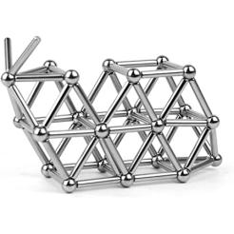
Case 1
3 year old child
  Recently given magnetic ball bearings as part of a toy
  Swallowed the magnets while playing unsupervised
  Swallowed multiple over 5 mins

Slide 30
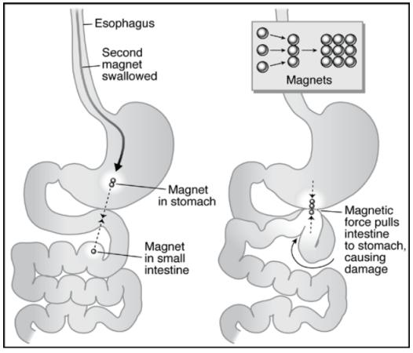
What’s the problem?

Slide 31
Picture of bowel coming on next slide
Look away if you wish for one slide!

Slide 32
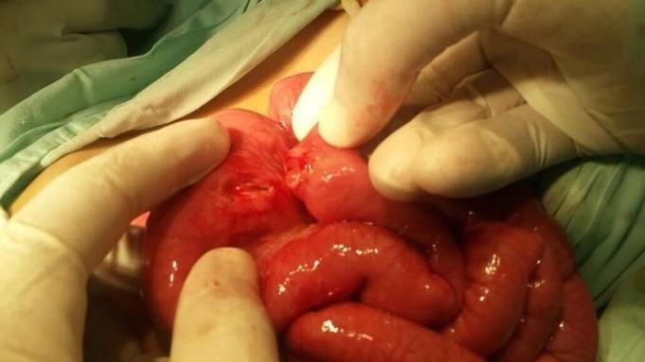
Bowel perforation

Slide 33
Patient required stoma
Stoma formation to help bowel to heal
Revised at 3 months
No ongoing concerns.

Slide 34
Case 2
11 year old girl
  Recent purchase of magnets
  Attempted to stick magnets around mouth and teeth
  Accidentally swallowed all together at same time

Slide 35
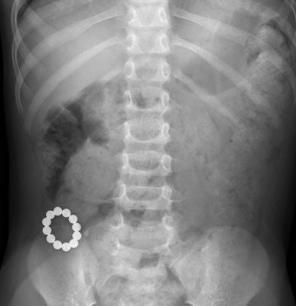
Common point to become stuck
Do most damage junctions
This is junction between large bowel and colon

Slide 36
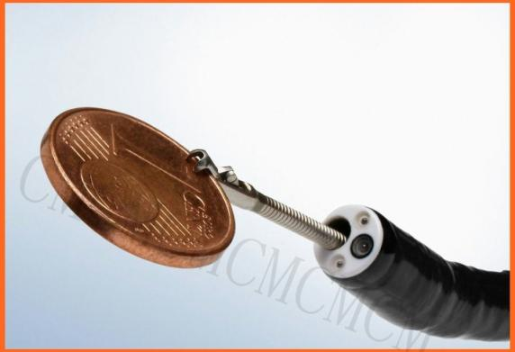
Endoscopic removal

Slide 37
The Scottish Trauma Network
Saving lives; giving life back
Mark Lilley
Lynsay Stewart
Jenna Hills
Major Trauma Coordinators
RHCmajortrauma@ggc.scot.nhs.uk
07977 030 660
@nhsggcpaedsMTC
@ScotTraumaNwk
Notes:
Hi
My name is Mark Lilley and I am one of the Major Trauma Coordinators at the Royal Hospital for Children in Glasgow.

Slide 38

A Partnership Approach

Slide 39

“Getting the right information to the right people at the right time”

Slide 40
Real time, targeted , free trusted ALERTS via email, text or voicemail
Geographic or demographic
Create and save recipient groups ( quick send ) – update / reassurance
Individuals can reply
Rate – Relevance, Content , Quality
Reports
Survey Tools – Community View , Community View Enhanced.
Neighbourhood ALERT Version 4 - 2021

Slide 41
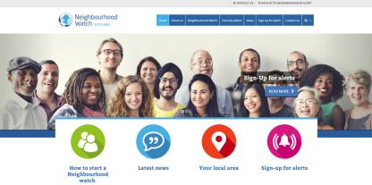
Scottish local ALERT network
78 Administrators currently listed (GDPR)
40 regarded as ACTIVE
26,606 direct registered users (17% growth in past year) across Urban and Rural communities (27% in last 2 years)
Over 1966 individual community groups
252 Alerts sent in past 3 months to over 700,672 recipients (shared with 2.1M)
96% satisfaction levels

Slide 42
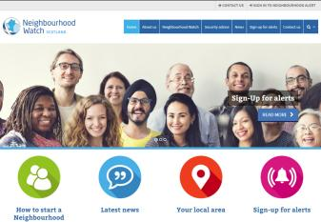

Scottish ALERT Portals
Think – different doors into same room!

Slide 43
Benefits
Users are on a single database which can be used by a number of partners to send trusted, direct, relevant ALERTS
Can just register to receive ALERTS (Don’t need to join a WATCH)
Duplication of messages are reduced
Community Safety Issues
Examples – COVID-19
Targeted Community Engagement - Partnership Approach

Slide 44
Contact
Neighbourhood Watch Scotland
www.neighbourhoodwatchscotland.co.uk
www.ruralwatchscotland.co.uk
Email : info@neighbourhoodwatchscotland.co.uk
Tele : 01786 463732

